Slide 1

Practicum: The bacterial genome and genetic variation by conjugation
Molecular Genetics
Course instructors
drs Vincent Stevens
drs Leila Paquay
dr Sofie Thijs
22/10/2020

Slide 2
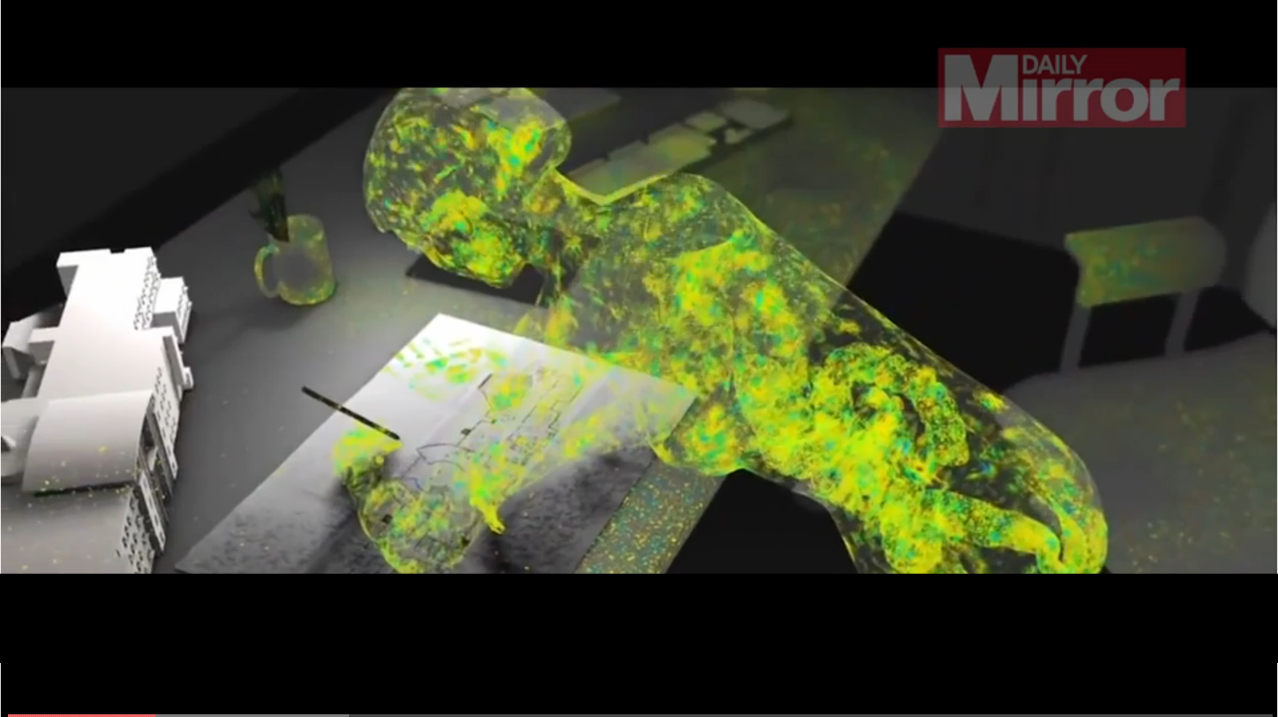
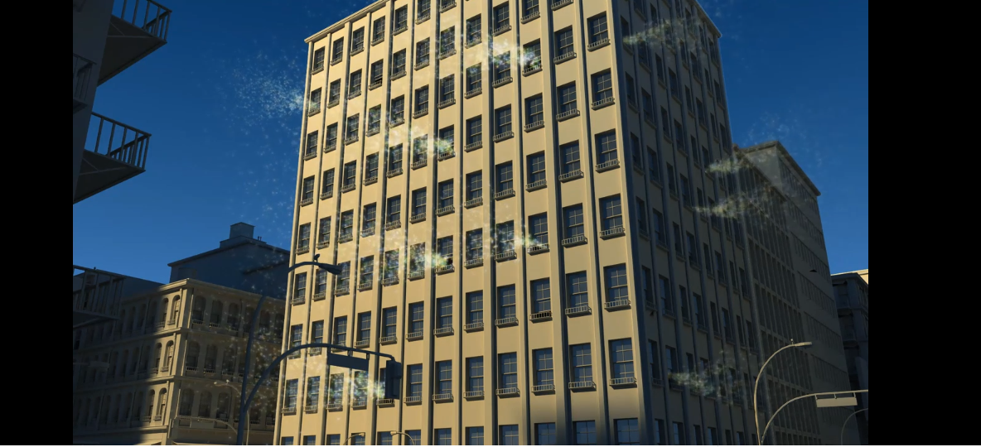
Bacteria are everywhere
Video: bacteria in our living environment

Slide 3
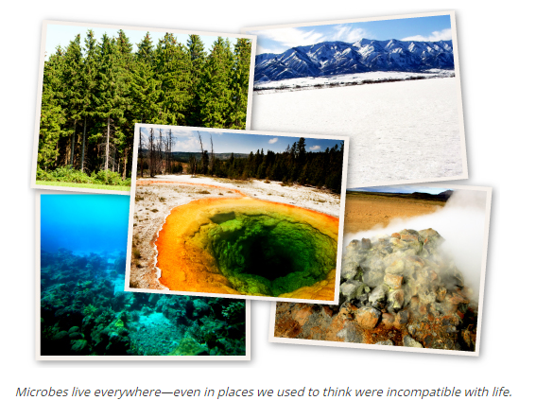
Bacteria are everywhere
They live independently in the environment (soil, water, air, …)
sometimes in extreme environments (geyser, deep trenches, volcano)
or in association with other living organisms
Microbes account for most of the diversity of life on our planet. More microbial species than plants, vertebrates, and insects combined.
In 1 gram soil: 10 000 000 000 bacterial cells and 4,000 different bacterial species
Bacteria have been around for billions of years.
Have adapted to nearly every environment on earth and can eat just about anything, including explosives, petroleum, and natural gas—all of which are toxic to us.
Notes:
Source picture: http://learn.genetics.utah.edu/content/gsl/diversity/

Slide 4
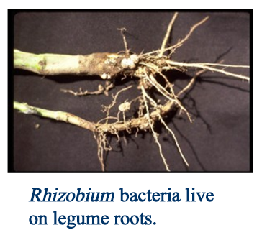
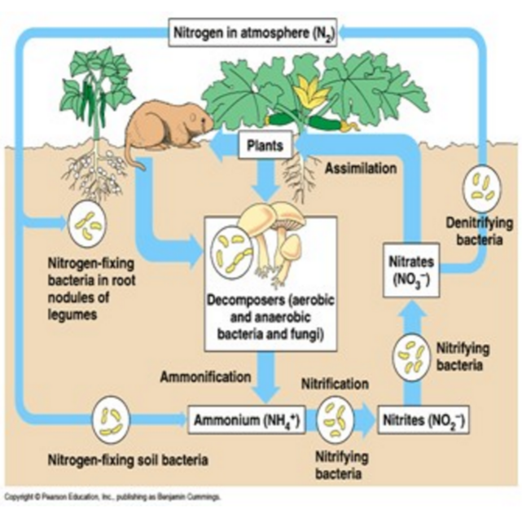
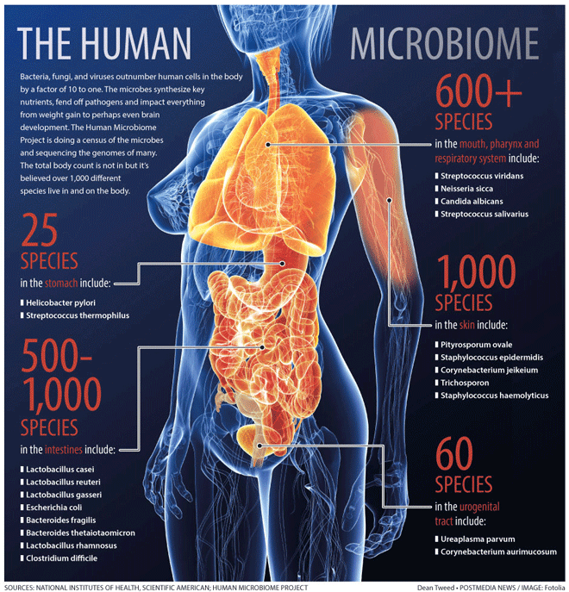
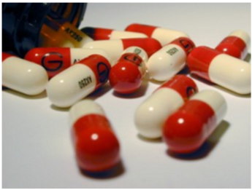

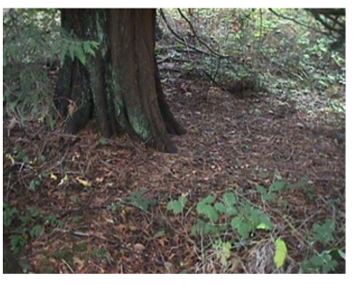
Studying the bacteria (and genome) is important in many ways
To understand how they influence human health
To understand their contribution to nutrient cycling (! Soil bacteria are crucial on Earth for the organic compound mineralisation)
To understand how they gave rise to Eukaryotic life (evolutionary perspective)
To use the genome information and the bacteria to produce pharmaceuticals (antibiotics, sugars, hormones, bioplastics, biofuels…)
To clean-up our environment: ‘contaminants’ can be food for bacteria: e.g. diesel-eating bacteria
Use of bacteria in the production of yoghurt, cheese, beer
Some bacteria make antibiotics to kill pathogenic bacteria,
Streptomycin and Erythromycin are made by bacteria
Several heterotrophic bacteria break down organic matter into usable compounds for plants
Several species of bacteria living in soil have the ability to uptake N₂, and convert to NH₃. Other bacteria convert this ammonia to nitrite (NO₂) and nitrate (NO₃)

Slide 5
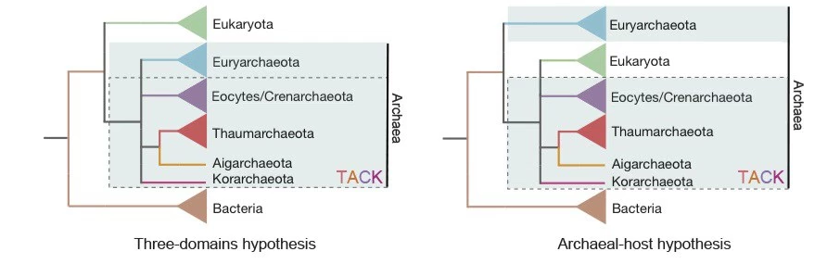

Genome insights in bacteria revealed drastically new insights in the tree of life!
First 3-domains of life
Now
2-domains of life
Williams et al., 2013 Nature
Hug et al., 2016, Nature
Archaea are our closest relatives!
http://www.nature.com/nature/journal/v504/n7479/full/nature12779.html
http://sitn.hms.harvard.edu/flash/2014/origins-of-eukaryotes-who-are-our-closest-relatives/

Slide 6
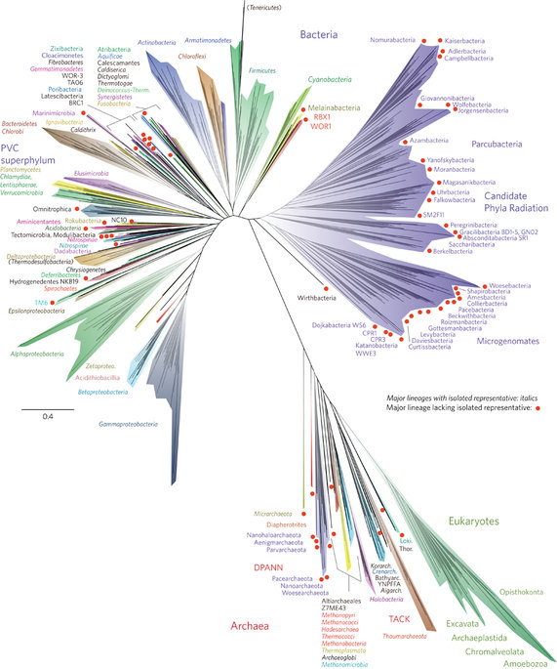
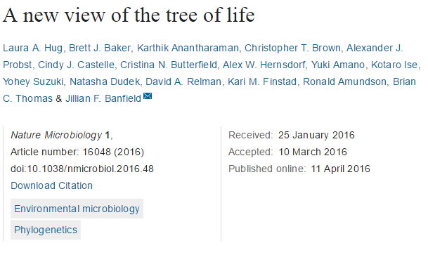
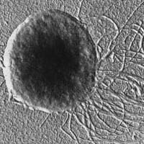
http://www.nature.com/articles/nmicrobiol201648#f1

Slide 7
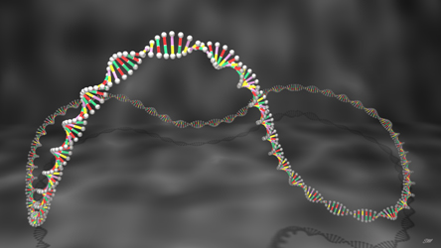
In this practicum you will discover, and understand the bacterial genome
You get bacterial strains isolated from soil, water, from different locations around the world
Some bacterial species you will work with are newly discovered and it is not known how the genome is organised
These bacteria can also acquire new genetic elements from other strains by conjugation, you are going to help nature a hand, and let the bacteria exchange genetic material

Slide 8

Learning outcomes
Conduct, plan and execute an experiment to extract genomic DNA and plasmid DNA from a bacterial strain, and visualize the results on an agarose gel.
Derive hypotheses for the differences in genome organization (presence of plasmid, yes or no) based on observations of the organisms lifestyle.
Explore horizontal gene transfer in bacterial cultures, by transfer of the plasmid encoding for the green-fluorescent protein between bacteria by conjugation.
To develop skills in molecular biology, and sterile techniques for handling bacterial cultures.
Interpret and compare gel results with fluorescence microscopy images, gfp-expression and the working of a fluorescence microscope.
Learn how to report against report guidelines.

Slide 9
Report guidelines
Requirements:
Introduction:
State the purpose of the investigation or experiment
State the key ideas or background biology
Formulate a question for an investigation
State a testable hypothesis
Figure + Results + short Discussion
Deadline: 3/11/2020
Feed-back: 5/11/2020
Report should be made with Word or similar
Language: Dutch
Font: Calibri 12 pnt
Line spacing: 1.5
Notes:
3rd bio: 7/11 en 27/11

Slide 10
Schedule of the practicum
Today
1. gDNA and plasmid extraction
2. Inspect the gel results
3. Perform a bacterial conjugation: let a donor bacterium exchange genetic material with your bacterium
4. Evaluate the outcome of genetic exchange by plasmid extraction, agarose gel and fluorescence microscopy
5. Inspect gel results
Tomorrow
Tomorrow
Monday
Monday

Slide 11
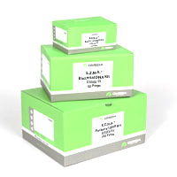
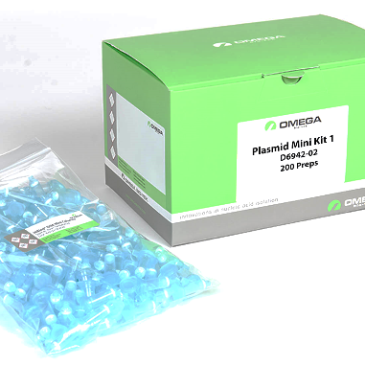

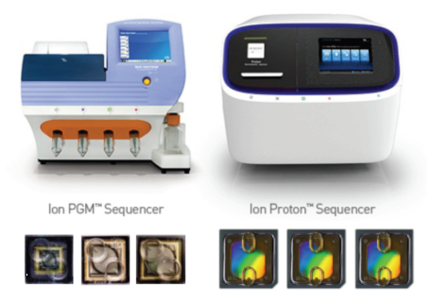
gDNA and plasmid DNA extraction: which methods
gDNA purification
Plasmid DNA purification
Phenol-chloroform method
Alkaline lysis
Good old methods
Kits: easier, faster
Black box? We need to understand
What happens in each step!
Commercial kits: EZNA bacterial DNA kit
EZNA plasmid DNA kit
gDNA shearing occurs
plasmid size range: 1-50 kb
Downstream application: Whole genome sequencing using NGS technologies

Slide 12
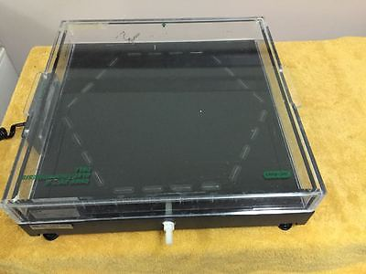
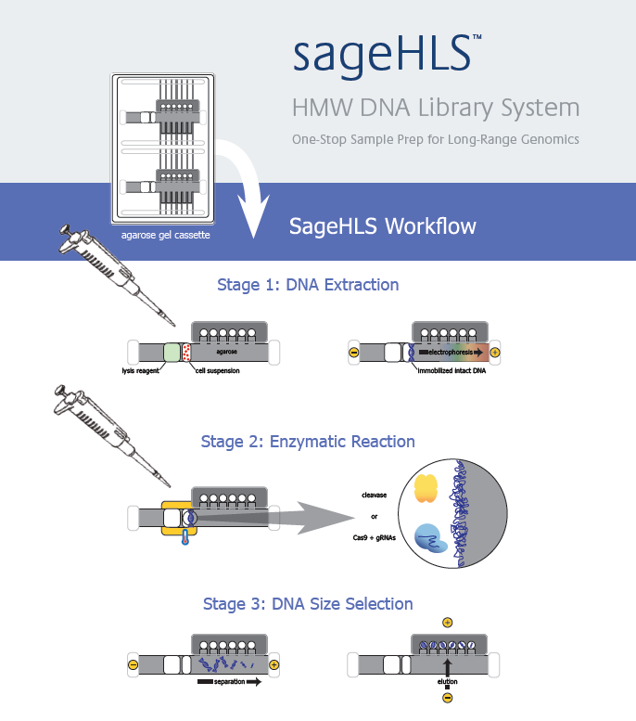
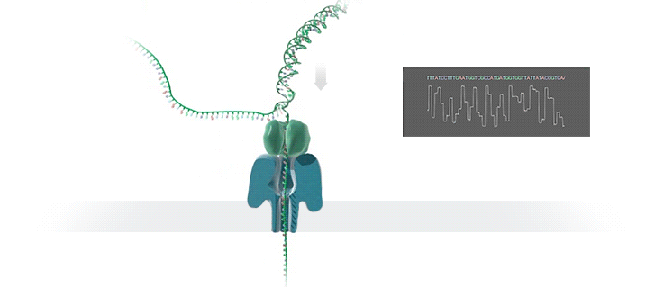
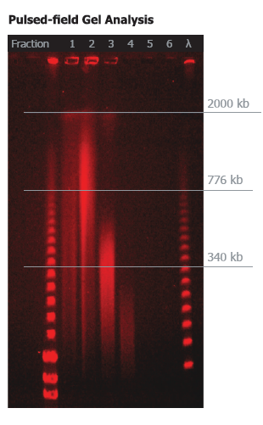
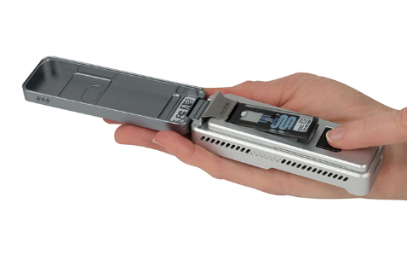
Other methods to isolate HMW DNA (for long-read sequencing techn.)
Pulsed field gel-electrophoresis
Ultra-high MW DNA extraction from cells: SAGE-HLS

Slide 13
Genomic DNA isolation

Slide 14
Basics: What is DNA
DNA: deoxyribonucleic acid
The blueprint for life
It is a molecule that encodes the genetic instructions used in the development and functioning of all known living organisms
DNA is a polymer or string of nucleotides
Each nucleotide is composed of a sugar, a nitrogen base and a phosphate backbone

Slide 16
Chemistry of DNA
The forces affecting the stability of the dubble helix include:
Hydrophobic interactions: at outside and inside helps in stabilising structure
Stacking interactions: Van der Waals forces, weak but stabilise the structure
Hydrogen bonding: facilitates stacking
Electrostatic interactions: destabilises , due to negative phosphates, can be neutralised with Na+ ions or proteins

Slide 17
Where is the DNA located?
Eukaryote:
Nucleus
Mitochondria
Plastids
Prokaryote:
Nucleoid
Plasmids
Plasmids

Slide 18
Chromid DNA
1. Extra-chromosomal DNA, approximately occuring in 1 out of 10 bacterial genomes
2. Secondary DNA
3. Linear or circular
4. Smaller then the main chromosome, but larger than plasmids
5. Can contain histones and proteines
6. Can contain essential and non-essentiel genes
7. Can be transferred presumably only through cell devision

Slide 19
How to take this DNA out of the cell?

Slide 20
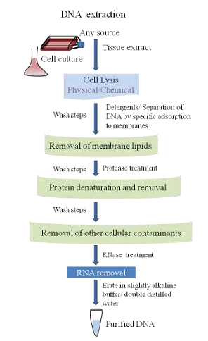
gDNA extraction
Cell wall lysis?
Which products do you add?
What happens in each step?

Slide 21
Plasmid DNA isolation

Slide 22
Steps
Plasmid DNA extraction is a bit trickier because plasmid DNA must be kept separate from gDNA
This separation is based on size, good separation relies on using the right lysis methods
Steps:
Alkaline lysis or cell disruption
Separation of plasmids from gDNA
Clearing of proteins and gDNA
Precipitating DNA
Which products do you add?
What happens in each step?
Difference with gDNA extraction?

Slide 23
DNA quantification How to check DNA that you extracted?

Slide 24
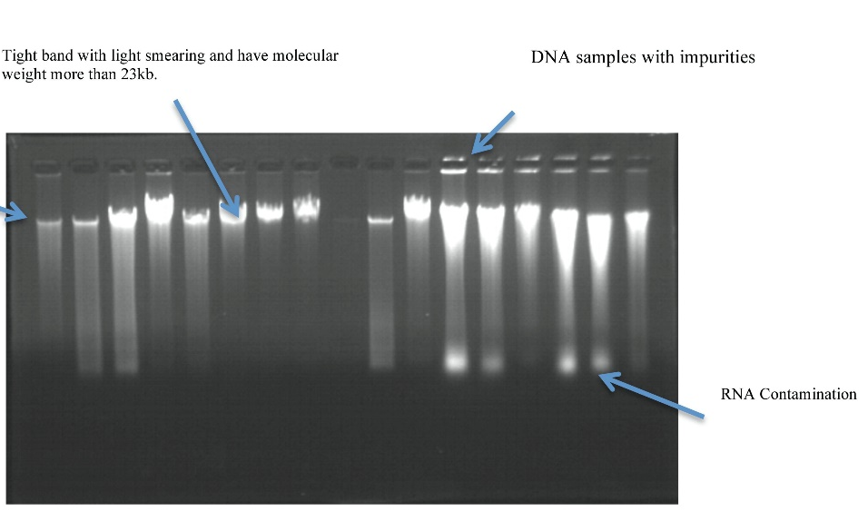
Electrophoresis in agarose gels

Slide 25
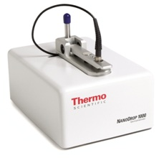
Electrophotometer/nano-drop
Gives the 260/280 and 260/230 ratio’s which
tells us about purity of DNA.
260/280 = 1.8-2.0 pure from proteins
260/280 = < 1.8 contaminated with prot.
260/230 = 2.0-2.2 pure
260/230 = < 1.8 contaminated with carbohydrates, phenol, salts, guanidine HCl
Also it quantifies and displays
concentration of DNA in ng/ul.

Slide 26

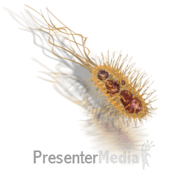
Practicum: The bacterial genome and genetic variation by conjugation
Don’t take the lab strains to your home!
Today
1. gDNA and plasmid isolation of bacteria
Let’s start!
Pay attention to:
Clean workbench with 70% ETOH
Were gloves => don’t contaminated your preps with Dnase, RNAse on your hands
Disposal of all tips, liquid waste in waste beakers!

Slide 27
During the 30 min breaks, search info about your strain - Where was it isolated? Can you deduce its growth conditions, temp., - Special features? Eg metal-resistance, natural plasmid, degrader of…
Bacterial strain ID | Origin of isolation | Reference if available
Novosphingobium sp. ST904 | Military soil, Belgium | NCBI ACC. LGJH00000000
Raoultella ornithinolytica sp. TNT | Military soil, Belgium | (Thijs et al., 2014)
Rhizobium sp.PXXIV | Agricultural soil, Argentina | NCBI ACC. MPVZ01000000
Ochrobactrum sp. PIII | Agricultural soil, Argentina | NCBI ACC. MPPJ00000000
Pseudomonas putida f1 | Soil | (Zylstra et al., 1988)
Pseudomonas putida Hs1 | Soil | (Kunz & Chapman, 1981)
E. coli sp. pMP4655 donor | Human host, gmo | (Bloemberg et al., 2000)
E. coli sp. prK2013 helper | Human host, gmo | (Ditta et al., 1980)
1
2
3
4
5
6

